Slide 1
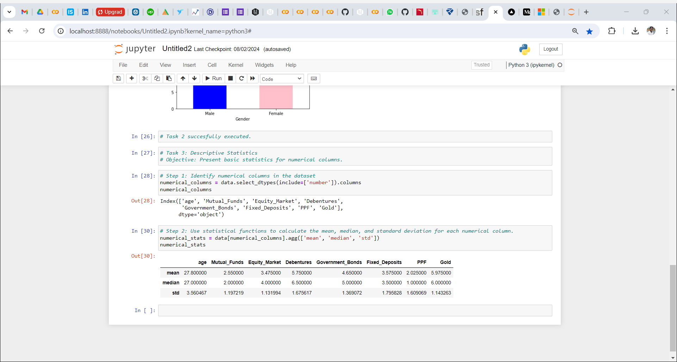
Task 3: Descriptive Statistics
Objective: Present basic statistics foR the numerical columns

